Slide 1
SUDOKU CHECKER

Slide 2
How to run & build
Make sure Golang installed on PC or system
run script setup

Slide 3
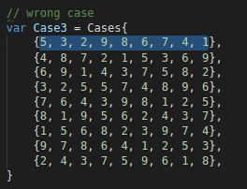
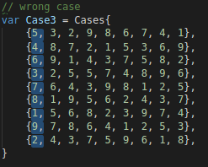
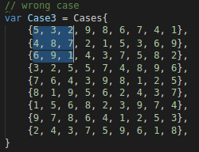
How It Works
The application will try to check all same digit / value horizontally, vertically, and Square 3 x 3

Slide 4
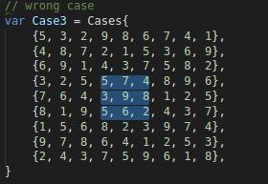
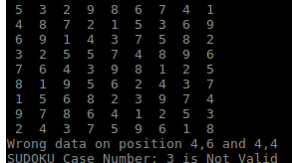
If its found same value on one of 3 that mode. system will immediately summmerize as not valid sudoku puzzle

Slide 5
In Normal case (right sudoku case) it will check until last data.
The Complexity about n³

